Slide 1
Translingual Europe 2010
Monday, June 7th, 2010
Hotel Maritim, Berlin, Germany

Slide 2
Translingual Europe 2010
Welcome Hans Uszkoreit, DFKI, Germany
On the Relevance of MT and Information on EC Calls Kimmo Rossi, European Commission, Luxembourg

Slide 3
Technicalities

Slide 4
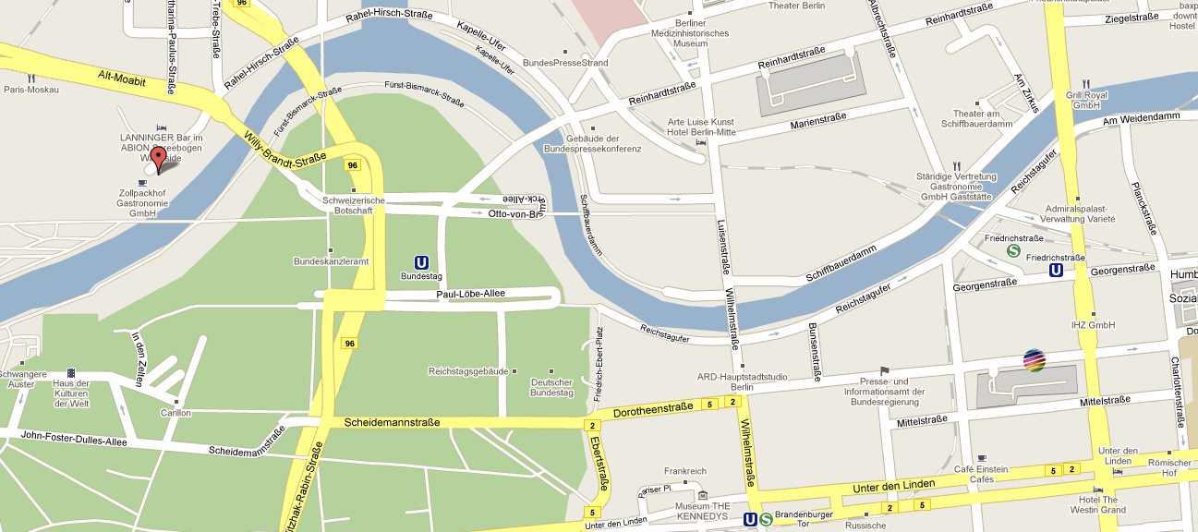
Opening Night Reception
Translingual Europe 2010 is co-located with Localization World.
The Localization World opening night reception is at Zollpackhof (near Kanzleramt and Berlin main station) at 19:00 tonight.
If you are not registered with Localization World, tickets for the reception are available at the Localization World desk for a small fee.

Slide 5
Wireless
Free wifi’s available for participants of Translingual Europe 2010.

Slide 6
Programme
Overview

Slide 7
Programme
09:30 Welcome
10:00 Opening Keynotes
11:00 Session Research and Innovation
12:30 Lunch
13:30 Session Language Industries
14:15 Panel Small Languages
15:00 Session Machine Translation Industries
15:45 Coffee Break
16:15 Session Machine Translation Users
17:00 Closing Keynote
17:40 Final Discussion
18:00 Finish

Slide 8
Programme
Opening Keynotes Chair: Josef van Genabith
10:00-10:30 Will Lewis (Microsoft, USA):
Haitian Creole: Developing MT for a Low Data Language
10:30-11:00 Lori Thicke (Translators without Borders, France):
Translation Technology for Fighting World Poverty

Slide 9
Programme
Session Research and Innovation Chair: Fabio Pianesi
11:00-11:20 Heyan Huang (Beijing Institute of Technology, China):
Recent Progresses on MT and Language Information Processing of CCLIE & BIT
11:20-11:40 Jaap van der Meer (TAUS, The Netherlands):
TAUS Data Association: News and Roadmap
11:40-12:00 Hans Uszkoreit (DFKI, Germany):
META-NET: Towards the Multilingual Europe Technology Alliance
12:00-12:20 Josef van Genabith (DCU, Ireland):
Evaluation, Localization and Open Source Tools in EuroMatrixPlus
12:20-12:30 Questions and discussion

Slide 10
Programme
Session Language Industries Chair: Gábor Prószéky
13:30-13:45 Willem Stoeller (Lingotek, USA):
Community Translation, what is it, when to use it, how to
manage it
13:45-14:00 Antione Rey (Welocalize, Ireland):
Welocalize Open Source efforts and MT integration
14:00-14:15 Andrejs Vasiljevs (Tilde, Latvia):
LetsMT! – Towards Cloud-Based Service for MT Generation

Slide 11
Programme
Panel Small Languages Chair: Sabine Kirchmeier-Andersen
14:15-14:25 Maltese: Mike Rosner (University of Malta, Malta)
14:25-14:35 Latvian: Andrejs Vasiljevs (Tilde, Latvia)
14:35-14:45 Dutch: Alice Dijkstra (Netherlands Organisation for Scientific Research, The Netherlands)
14:45-15:00 Discussion

Slide 12
Programme
Session MT Industries Chair: Gudrun Magnusdottir
15:00-15:15 Kirti Vashee (Asia Online, Thailand, USA):
Asia Online Technology Platform Overview & Vision
15:15-15:30 Mikel Forcada (Apertium, Ireland):
Free/Open-Source Machine Translation: The Apertium Platform
15:30-15:45 Julia Epiphantseva (ProMT, Russia):
Flexible and efficient management of translation quality

Slide 13
Programme
Session MT Users Chair: Lori Thicke
16:15-16:30 Patrizia Biani (European Patent Office, Germany):
The Evolution of the European Machine Translation Programme at the EPO
16:30-16:45 Spyridon Pilos (European Commission, Luxembourg):
New Developments on MT at the European Commission
16:45-17:00 Fred Hollowood (Symantec, Ireland):
2010: The Industrialisation of MT

Slide 14
Programme
Closing Keynote Chair: Hans Uszkoreit
17:00-17:40 Sabine Andersen-Kirchmeier (Danish Language Council):
Language Change and Linguistic Diversity – Future Challenges for MT
17:40-18:00 Final Discussion
18:00 Finish

