Slide 1
Welcome
to the
^{BERLIN THEME} ^{TANK}

Slide 2
^{BERLIN THEME} ^{TANK}
What is the Berlin Theme Tank?
it is not a symposium, colloquium or another established type of academic event
it is not a conference
it is not a consultation meeting
it is planned as a brainstorming meeting for presenting, developing and discussing brave ideas that may shape our research and funding for the coming ten years

Slide 3
Brief Overview
^{BERLIN THEME} ^{TANK}
Hans Uszkoreit

Slide 4
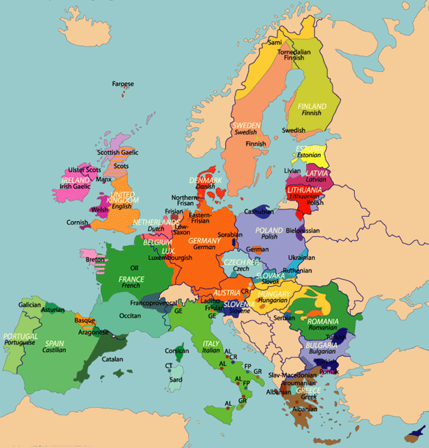
A Socioeconomic Problem
A core component of the European Union is a common market with a single information space that works with two dozens national languages and many regional languages. This ambitious endeavour is an unpre- cedented social experiment.
If it works, the multicultural union of nations will prosper and serve as a model for the peaceful and egal- itarian cooperation of people in other parts of the world. If it fails, Europe will be forced to choose between sacrificing cultural identities and economic defeat.

Slide 5
Major Challenges
Preserving the European cultural and linguistic diversity in the united information and knowledge society
Securing at affordable costs the free flow of information and thought across language boundaries in the resulting single information space
Providing each language community with the most advanced technologies for communication, information and knowledge management so that maintaining their mother tongue does not turn into a disadvantage

Slide 6
Motivation: A Conflict of Goals?
Europe from a linguistic viewpoint
With its 23 offical languages and numerous other local variants and dialects, Europe is rather unique.
Goal 1: We should preserve the diversity of this cultural heritage.
Europe as a modern information society
It‘s a commonplace that communication is the key to success.
Goal 2: All EU-inhabitants should have equal access to information and be able to participate.

Slide 7
Starting Point
Where are we today?
Research has made considerable progress in recent years.
Successful projects have been funded by the EU and national programs.
But: the pace of progress is not fast enough to meet the three challenges within the next 10-20 years.
Can progress be accelerated?
Yes. But only if the relevant stakeholders such as research communities, LT industry, user industries, language communitites, funding programs and policy makers team up for a dedicated major push.
We need an alliance of stakeholders dedicated to a large concerted effort.

Slide 12
The Lyulin Highway
length: 19 km
costs: 137 MEURO planned (but large cost overrun)
EU contribution ≈ 102.8 MEURO
actual building time >2 years

Slide 13
What the hell...
Q: What does the Lyulin Highway have to do with EU LT Research?
A: Absolutely nothing!
BUT:
Q: Taken the importance of the preservation of linguistic diversity and the high priority of the single digital market, could we all together–researchers, industries and users– convince the politicians to spend the equivalent of a 93 km of highway on push in LT research and development? (>500 MEURO)
A: Maybe, under certain conditions...

Slide 14
One more Question
Q: How do we get such an alliance formed? A: The remainder of the talk will present our proposals.

Slide 15
Our Mission
As researchers, how can we help to create the Alliance?

Slide 16
Old Proverb
Science is changing the world, scientists can hardly change their socks.

Slide 17
A Simple Mechanism
a strong community
with ties into other R&D communities
with a network into industry and public administration
with visions and plans
visibility and credibility
powerful support from many sectors
massive additional resources

Slide 18
Examples from other Fields
ARTEMIS – the European Technology Platform for Advanced Research and Technology for Embedded Intelligence and Systems
AAL – The Ambient Assisted Living Joint Programme
EPoSS – The European Technology Platform on Smart Systems Integration
NEM – The European Technology Platform on Networked and Electronic Media
NESSI – The European Technology Platform Networked European Software and Services Initiative

Slide 19
Multilingual Europe Technology Alliance
META is dedicated to foster the technological foundations of the European multilingual information society to:
enable communication and collaboration among people without language boundaries,
secure users of any language equal access to the information and knowledge society, and
push forward functionalities of networked information technology.

Slide 20
META-NET is ...
... a Network of Excellence with three major objectives
Prepare the grounds for a large scale concerted effort by building a Strategic Alliance of national and international research programmes, corporate users and commercial technology providers and language communities.
Strengthen the European research community through networking of research and by creating new schemes and structures for sharing resources and efforts.
Build bridges by approaching open problems in collaboration with other research fields such as machine learning, social computing, cognitive systems, knowledge technologies and multimedia content.

Slide 21
Initial Funding: T4ME
T4ME NET : Technologies for the multilingual European Information Society
Funded under FP 7
Area: Language-based interaction (ICT-2009.2.2)
Project Reference: 249119
Total cost: 7.62 million euro EU contribution: 5.99 million euro
Execution: From 2010-02-01 to 2013-01-31
Duration: 36 months
To avoid multiple names and to permit other centers, projects and individual to join we will exclusively use the name META-NET

Slide 22
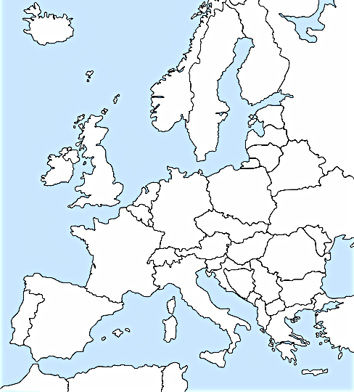
Founding Members
Dublin City University
Laboratoire d'Informatique pour
la Mécanique et les Sciences de
l'Ingénieur

Slide 23
Three Lines of Action
The META-NET objectives translate into three lines of action:

Slide 24
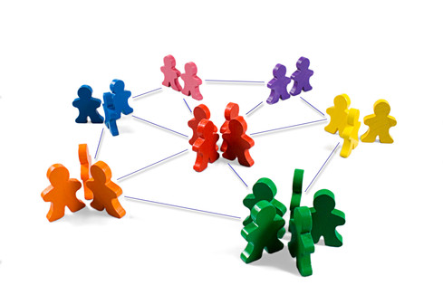
Goal: Mobilize researchers, enablers, providers, (potential) users of technologies, R&D programmes for cooperation in META
Actions:
Survey the field
Create a shared vision that feeds into
a Strategic Research Agenda
Build a multiplayer community via
external liaisons, promotion, etc.
Spread knowledge in training events

Slide 25
Pillar III: Building the Community
A META Survey will investigate to what degree the languages of Europe are supported by applications, technologies, resouces and what their current status is the digital world is. (23+ concise Language Reports)
Vision Groups will bring together researchers, developers, integrators and (actual or potential, corporate or professional) users of LT-based products, services and applications.
A Technology Council will prepare a vision paper “European Multilingual Information Society 2020”, a comprehensive Roadmap including individual roadmaps for key socio-economic sectors, light-tower application visions.
Finally, a Strategic Research Agenda (SRA) will be presented by the Council.

Slide 26
Planned Vision Groups
Text translation (technical doc consumer info., official bulletins,…)
target stakeholders: large users of translation services, translation companies
Software and content localisation (UI localisation, games, services, …)
target stakeholders: software companies, game companies, localisation industry
Media and information services (audiovisual sector, news, digital libraries, portals, search engines, …)
target stakeholders: media industries, web and search engine providers, archives
Interactive systems (mobile assistance, dialogue transl., call centres, …)
target stakeholders: mobile software and service providers, telecom industry, call centres
Council
Council
Council

Slide 27
Community Involvement in Planning/Visioning
Propose members of Vision Groups
work in Vision Groups
Provide input via a web-based discussion forum, will be on the META-WEB site
Contribute to language reports
Participate in the Annual Conference, etc. (the first one planned for Nov. 2010)

Slide 28
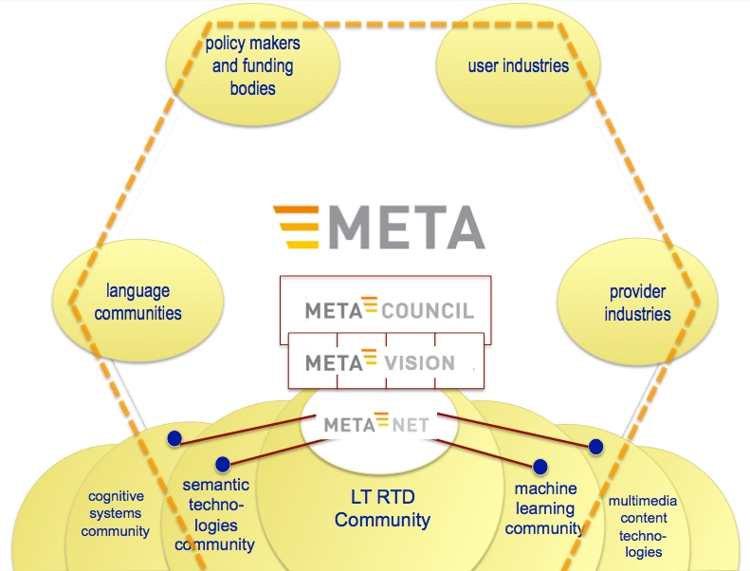

Slide 29
Danger
Society will not support large scale efforts for commercial applications that we would have anyway in a few years
Will specialised vision groups dominated by industry really develop visions that
are courageaous and far-reaching
exploit the full potential of possible scientific progress
are convincing enough for a major financial investment by European society
Maybe – Maybe not
The vision groups need to be provoked to come up with grand visions

Slide 30
Provocation
In answering research questions, scientists need to be careful, accurate and honest
In asking research questions, in dreaming up scientific and technological opportunities, scientists should be creative and courageous

Slide 31
^{BERLIN THEME} ^{TANK}
This workshop should be one source of provocation for the vision and planning process
provide stimulating provocative input to the vision planning process
other input will be solicited from colleagues who are not present here
the ideas collected here could also help to solicit the additional input
participants will hopefully benefit intellectually from having been part of the “collective dreaming” process
it may also help them to test and sharpen their own ideas and discover possible partnerships and alliances

Slide 32
^{BERLIN THEME} ^{TANK}
Therefore:
present your wildest ideas (with or without slides)
take up to ten years as the scope for large research actions
don‘t be cautious
comment on ideas, add, modify and extend them

Slide 33
^{BERLIN THEME} ^{TANK}
Procedure:
Record all contributions (video-recording and notes)
condense notes and recordings
send these to particpants for comments and last filtering
put up the results on the web for discussion and ask for more ideas
merge and condense all contributions
deliver these condensed results to the vision groups as input

Slide 34
Data have become a key factor in LT research and development
indicators:
size and importance of LREC
corpora list
citation ranks of publications on resources
Language research and language technology belong to “Data Intensive Science”
As in other sciences, expensive data become valuable through sharing
HOWEVER: the long demanded and well-contemplated instruments for managing and sharing are still missing

Slide 35
First step: META-SHARE
META-SHARE is an
open,
integrated,
secured,
and interoperable
language data and tools exchange infrastructure for the HLT (Human Language Technologies) domain and other applicative domains (e.g., digital libraries, cognitive systems, robotics, etc)

Slide 36
Intended Properties of META-SHARE
a marketplace where language (and related) data and tools are documented, uploaded and stored in repositories, catalogued and announced, downloaded, exchanged, combined, etc. aiming to support a data economy,
ever-evolving, scalable, incl. free and for-a-fee LRs/LTs and services;
including legacy, contemporary and emerging datasets, tools and technologies
based on distributed networked repositories accessible through common interfaces;
standards-compliant, overcoming format, terminological and semantic differences; allowing/enabling service offerings
complying to legal and security related restrictions

Slide 37
Action Line Building Bridges
Cooperation, building bridges
Within the project (machine translation community)
Outside (neighbouring research communities like machine learning, knowledge management, etc.)
First-class research
… in the usual sense: published results, major events
Provide free / open resources
for Pillar 2 “consumption” (and testing)

Slide 38
Selected areas for building bridges and opening new avenues
Bringing more semantics into translation
Optimising division of labour in Hybrid MT
Exploiting the “context” for translation
Broaden the empirical base for machine translation

Slide 39
The Virtual Information Center (VIC)

Slide 40
Why should YOU participate
YOUR VOICE IS IMPORTANT, as is your language! But not only…
Europe’s language industry including language technology is considered worth 8.4 billion EUR, with an estimate of doubling this figure by 2015. Globalisation (of business), mobility (of persons) and immigration add to the increased need for multilingual services and solutions. In participating in META, you will shape the future of Europe’s linguistic landscape. and
With the appropriate plans and mobilization, we will be able to boost LT support significantly. In participating in META you will shape Europe‘s LT landscape.

Slide 41
How can YOU participate (1)
Centers of Excellence in language technology research will be involved as additional nodes of META-NET to strengthen its competencies and its geographic and linguistic coverage.
For researchers, technologists, professionals, users and administrators developing, providing or using language technologies, META offers a unique platform to participate in discussions, working groups and planning activities thus shaping the linguistic future of Europe. They contribute ideas, become advocates for specific languages, technologies and applications or stay informed.
Research and technology development projects can provide and use shared resources and become part of META-SHARE. They help to plan and validate META services.

Slide 42
How can YOU participate (2)
Commercial enterprises are welcome to contribute their visions on products and services, participate in the planning process and use META for building profitable partnerships.
Educators, schools, journalists, media, politicians, public administrations and organisations participate in the public discussions on the visions and the steps towards a truly multilingual information society.

Slide 43
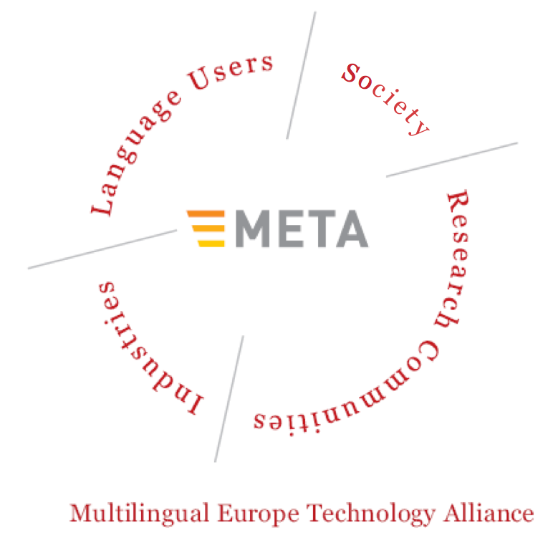
Where to Start
http://www.meta-net.eu
office@meta-net.eu

Slide 44
^{BERLIN THEME} ^{TANK}
Format:
three keynote presentations
Today Friday: Martin Kay, Stanford U.
Tomorrow Saturday: Wolfgang Wahlster, DFKI Chengqing Zong, CAS
several short presentations
discussion for each presentation
general discussions and impromptu presentations
a participants list is being completed and sent to all participants

Slide 45
^{BERLIN THEME} ^{TANK}
 |  | FRIDAY
14 | :00 | Uszkoreit
 | :15 | Uszkoreit
 | :30 | Kay
 | :45 | Kay
15 | :00 | Pinkal
 | :15 | Calzolari
 | :30 | Flickinger
 | :45 | Karger
16 | :00 | Break
 | :15 | Break

Slide 46
^{BERLIN THEME} ^{TANK}
^{PROGRAMME}
 |  | FRIDAY |  |  | SATURDAY
14 | :00 | Uszkoreit | 9 | :00 | Wahlster
 | :15 | Uszkoreit |  | :15 | Wahlster
 | :30 | Kay |  | :30
 | :45 | Kay |  | :45 | Pianesi
15 | :00 | Pinkal | 10 | :00 | Sasaki
 | :15 | Calzolari |  | :15 | van Genabith
 | :30 | Flickinger |  | :30 | Ananiadou
 | :45 | Karger |  | :45 | Break
16 | :00 | Break | 11 | :00 | Break
 | :15 | Break |  | :15 | Zhong
 | :30 |  |  | :30 | Zhong
 | :45 |  |  | :45 | de Rijke
17 | :00 |  | 12 | :00
 | :15 | Copestake |  | :15 | Discussion Wrapup
 | :30 |  |  | :30 | Discussion Wrapup
 | :45 | Uszkoreit |  | :45 | Discussion Wrapup
18 | :00 |  | 13 | :00 | End
 | :15 | Romary
 | :30
 | :45 | Discussion
19 | :00 | End

