Slide 1
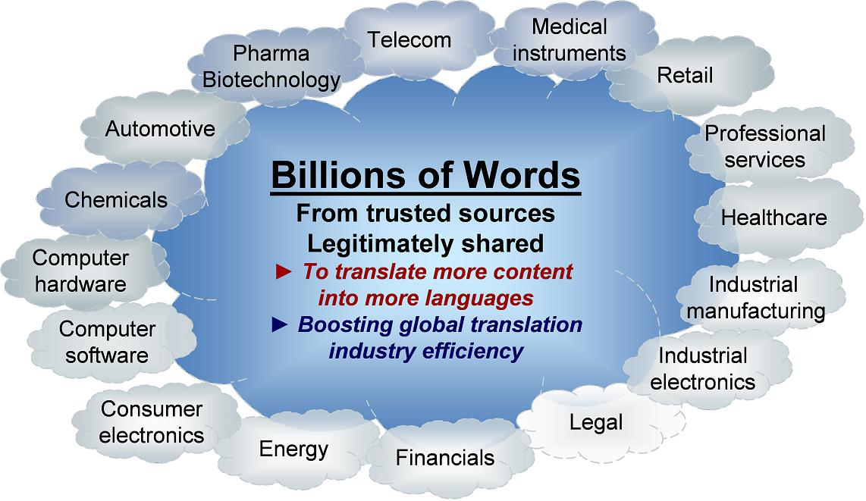
Implement an Industry Vision
One global platform open to all stakeholders in the translation industry

Slide 2
TDA Services
TM Sharing Services – for members only
Upload and download translation memories
Search – free & open to the public
Look-up translations of terms and phrases

Slide 3
Benefits of Search
Increase quality and speed of translation
Resolve QA bottlenecks
Resource for support and engineering
Streamline industry terminology
Translators training and research

Slide 4
Benefits of TM Sharing
Advanced leveraging: 35% to 50%
Improved performance of machine translation: 50% jump in BLEU score
Springboard for new value-added services

Slide 5
How People Use TDA Today Start with uploading your TMs
 | Action | Result | Saving
Terminology | Upload your TMs. If you are concerned about sharing TMs for other members to download, you can tick the box “For Search Only”. Ask your translators and reviewers to use TAUS Search to look up terms and phrases. | It seems so obvious, but most people can’t look up terms and phrases in the whole corpus of their TMs. TAUS Search lets everyone find translations in all of your uploaded TMs, and they may opt to search across industry. This will help to solve translation and review bottlenecks, saving time, increasing quality and consistency. | 5%-10%
Translation Memory | Select TMs for downloading by industry or data owner while checking the volume counter. The success of additional leveraging is dependent on finding sufficient proximate language data. You can import the TMX files in your regular translation editor and start leveraging translations. | If you get less than 5% matches from the TMX files you have downloaded from TDA, you may want to try another translation tool. Leveraging translations from large TM corpora is different than the traditional project-based TM approach. Phrase-based leveraging, supported by statistical routines and linguistic intelligence in a corpus-TM environment can generate 10% to 50% or more high-fuzzy matches. | 10%-50%
Machine Translation | Select TMs for downloading by language pair, data owner, industry and/or content type. You can use the TMX files for the training of MT engines. The TMX tags usually need to be removed. You can use the TM files for the training of the “translation models” and also use the target side for the training of the “language model”. The size of the corpus to be used for training depends on the engine and other factors. Hybrid rule-based models usually require smaller volumes than statistical engines. | The success of MT training is measured in metrics such as BLEU score. Pilot projects have shown significant increases in quality of up to 50% as a result of using much larger collections of data from TDA. Good quality MT output can double or quadruple the translation/post-editing productivity, or allow publishers to provide real-time fully automatic translation of for instance support content. | 50%
Benefits from terminology (TAUS Search) can be obtained easily and quickly. The benefits from TDA for translation memory and
machine translation require planning and investment of time and resources. Twenty out of the sixty current members seem to be
making these investments at the moment, whether directly or via their language service providers.

Slide 6
Ideas for New Features & Services
 | New service or feature | Benefits
Terminology | Multi-word translation. Currently we compute translations for single words only. Extending this computed translation to include phrases. | Better translation quality and saving more time and cost.
 | Synonym search. Allow TAUS Search to automatically find related terms and their translations in context. | Better translation quality and saving more time and cost.
 | Matrix search. Allow to search across all language pairs (instead of primarily from and into English). | Make TAUS Search beneficial for more users and more languages.
TM | Tool compliance. Currently all TMs are stored in a neutral TMX format. This features allows users to also store TMs in the tool compliant format, optimizing the leveraging within the same tool. | TDA can be used for all TM sharing by virtual translation teams without using any leveraging.
 | Translation Matching. This feature allows users to upload new documents and retrieve all matches from the entire TDA repository in a TMX format. | Easy way to retrieve all matches from the entire ding atabase. Bonus on matches.
TM & MT | TM Cleaning. A statistical tool that filters out suspicious translation units. | Eliminate bad quality translations.
 | Matrix TM. Allow users to extract TMs from TDA in all language pairs (as ong as data owner and product line correspond). | Allow TM leveraging in new languages.
 | Matching scores. A statistical tool that allows users to identify the best matching data for a particular job and to zoom in or out depending on the volume or accuracy requirements. | Ideal for optimizing data selection.
MT | MT Trainer. Allows users to upload TMs and request new engines to be trained through TDA users based on TDA data sets. | Access and compare engines for all languages and niches.
 | Genre identification. Statistical tool that identifies content types, helping users to select data of the same genre for MT training. | Ideal for optimizing data selection.
Private: members may limit sharing of TMs to their own selection of registered users (‘private vaults’).
Integration: API’s for all services will be available to everyone.

Slide 7
Development Priorities
Please indicate below the priorities that you would like to give to the planned features described in the TDA Roadmap 2010 document.
 | Highest priority | High priority | Lower priority | Lowest priority | Average score | Priority
Tool compliance | 10.5% (2) | 57.9% (11) | 26.3% (5) | 5.3% (1) | 2,26 | 6
Matching Scores | 25.0% (5) | 50.0% (10) | 20.0% (4) | 5.0% (1) | 2,05 | 3
TM Cleaning | 45.0% (9) | 35.0% (7) | 15.0% (3) | 5.0% (1) | 1,80 | 1
Translation Matching | 42.1% (8) | 36.8% (7) | 15.8% (3) | 5.3% (1) | 1,84 | 2
API Translation Matching | 25.0% (5) | 50.0% (10) | 20.0% (4) | 5.0% (1) | 2,05 | 3
Search Plug-in | 40.0% (8) | 15.0% (3) | 45.0% (9) | 0.0% (0) | 2,05 | 3
MT Trainer & Evaluator | 40.0% (8) | 15.0% (3) | 30.0% (6) | 15.0% (3) | 2,20 | 5
API MT Trainer | 30.0% (6) | 25.0% (5) | 30.0% (6) | 15.0% (3) | 2,30 | 7
Synonym Search | 20.0% (4) | 35.0% (7) | 30.0% (6) | 15.0% (3) | 2,40 | 8
Multi-word Translation | 20.0% (4) | 55.0% (11) | 15.0% (3) | 10.0% (2) | 2,15 | 4
Matrix Search | 10.0% (2) | 35.0% (7) | 45.0% (9) | 10.0% (2) | 2,55 | 9
Matrix TM Repository | 10.0% (2) | 40.0% (8) | 35.0% (7) | 15.0% (3) | 2,55 | 9

Slide 8
Strategic Actions
Adjustment annual fees in line with size of operation and realizable benefits. Moderate increase for ‘large members’
Make API’s publicly available
Open sourcing all TDA software components
Open for sponsoring and funding
Open to TM Sharing (For Search Only) for ‘fair use’
Partner Agreements for data & member acquisition
Development priorities
Translation Matching (sponsored)
TM Cleaning
Matching Scores

Slide 9
How can you contribute and participate
Use Search – API integration
Share translation memories – API integration
Join TDA as a new member

