Slide 1
Future Spoken Dialog Systems:
Multimodal, Multilingual, Multiparty, Multitask
Berlin
THEME TANK
5 June 2010
Wolfgang Wahlster
German Research Center for Artificial Intelligence
DFKI
Saarbrücken, Kaiserslautern, Bremen, Berlin
e-mail: wahlster@dfki.de
WWW:http://www.dfki.de/~wahlster

Slide 2
13 Trends for Spoken Dialog Systems
1. From Unimodal
to Multimodal Dialogs
2. From Monolingual
to Multilingual Systems
3. From Single Task
to Multitask Dialogs
4. From Dyadic Dialogs
to Multiparty Conversations

Slide 3
13 Trends for Spoken Dialog Systems
5. From Close Speaking
to Microphone Arrays for Distant Speaking
6. From Cooperative Speech
to Spontaneous Speech
7. From Stationary
to Mobile Spoken Dialog Systems
8. From Hosted Voice Portals
to Cloud-based Speech Solutions

Slide 4
13 Trends for Spoken Dialog Systems
9. From Client-Server Spoken Dialog Systems to Embedded Systems
10. From Database Transactions
to Problem Solving Dialogs
11. From Access to the Web of Information
to the Internet of Services
12. From Generic
to Personalized Voice User Interfaces
13. From Human-Machine
to Human-Environment-Interaction

Slide 5
Multimodal Dialog Systems
Graphical User
interfaces
Spoken
Dialogue
Gestural
Interaction
Multimodal
Dialog Systems
Haptic
Interaction
Video Input
Physical
Action

Slide 6

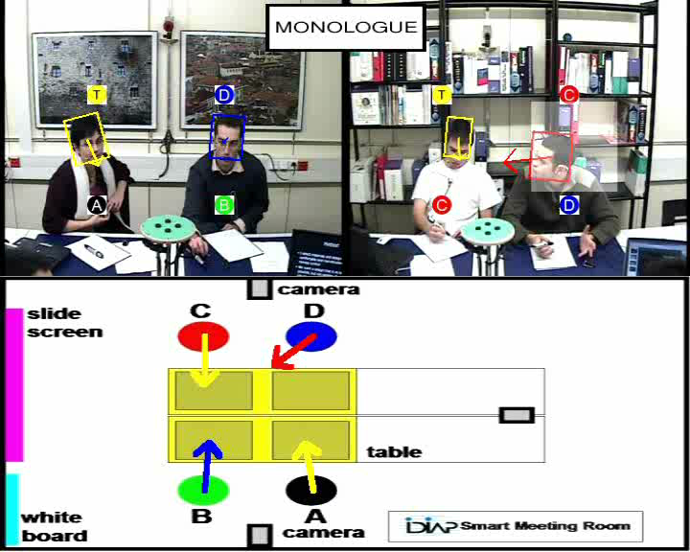
Multiparty Speaker Diarization and Tracking
Who spoke When, with Whom , Where about What?
Overlapped,
non-native
accented
and
spontaneous
Speech

Slide 7
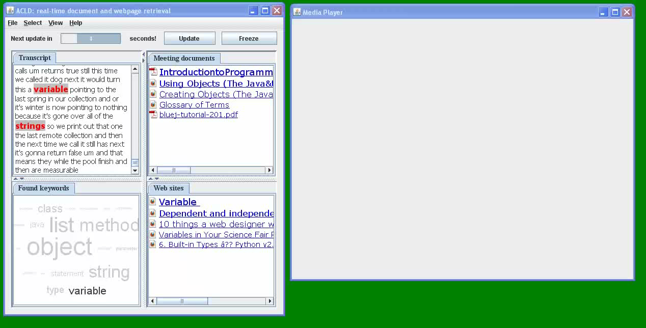
Just-in-time Access to Relevant Documents
or Fragments of Past Recorded Meetings
Killer App for Call Centers: Just-in-Time Answer Retrieval during the Conversation
between an Agent and a Customer by Parallel Speech Understanding

Slide 8
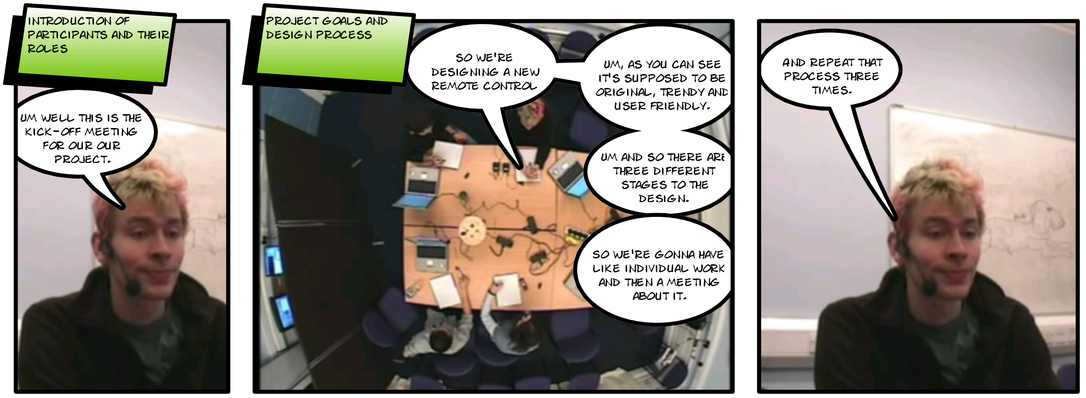
SuVi: The Generation of Meeting
Summaries as Story Boards in Cartoon Style
Still pictures extracted from video capture,
cartoon-style speech balloons for spoken dialog contributions
and text boxes for the results of topic detection

Slide 9
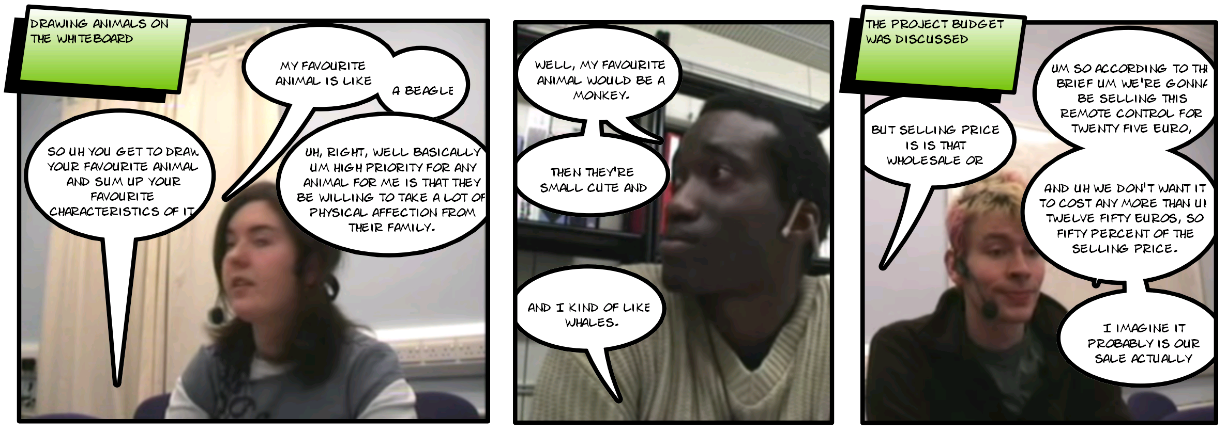
SuVi: The Generation of Meeting Summaries
as Story Boards in Cartoon Style
Still pictures extracted from video capture,
cartoon-style speech balloons for spoken dialog contributions
and text boxes for the results of topic detection

Slide 10
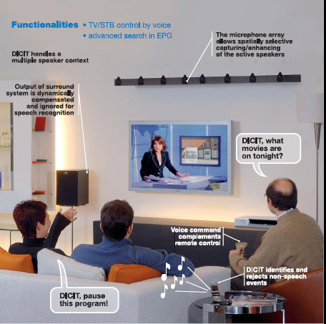






DICIT (Distant-talking Interfaces for Control of
Interactive TV) EC project
Coordinated by FBK
Goal: voice control of TV and related devices
Robustness against noise and audio interferences
Smart processing also including a real-time multi-speaker localization
Understanding of voice input queries
Multimodal spoken dialog management
For more details: http://dicit.fbk.eu

Slide 11
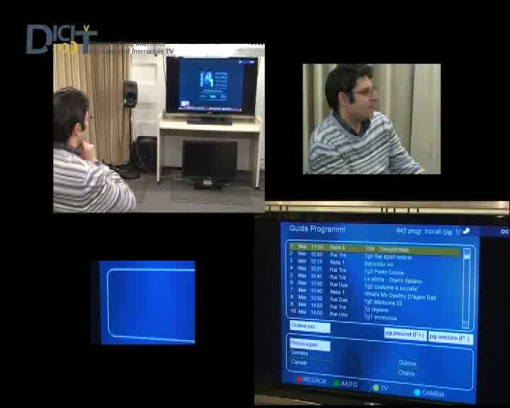
Multilingual Access to a Electronic Program Guide (EPG) with Distant Speech

Slide 12
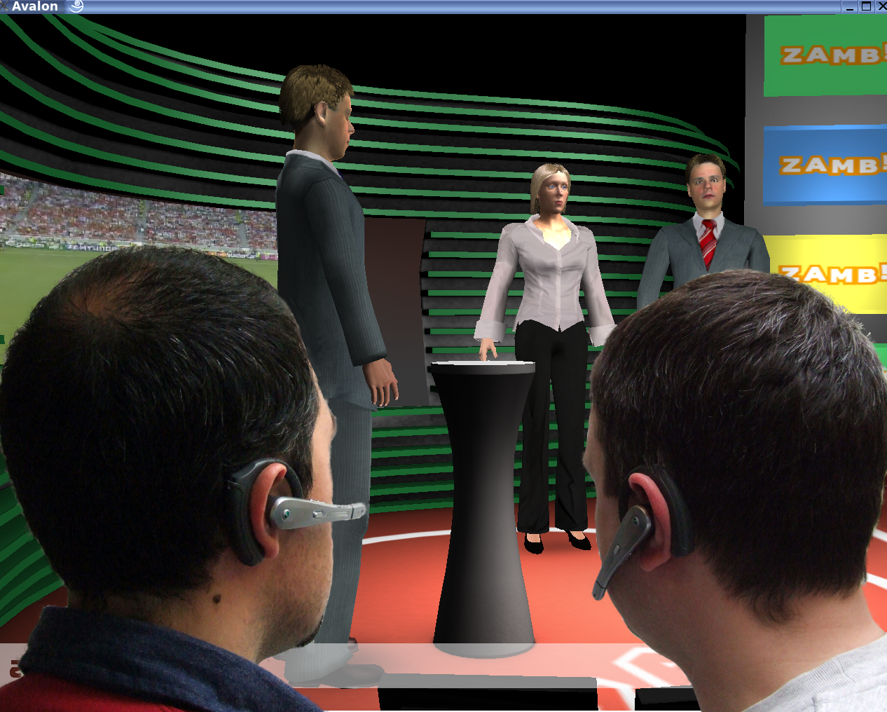
Multiparty Dialog between Virtual & Human Football Experts: Discussing the UEFA EURO 2016 in France
N > 2 Virtual
Experts
Multilingual
Virtual
Moderator
Virtual TV Studio
n > 2 Human Football Fans from Different EU Member States Speaking
their Mother Tongues

Slide 13
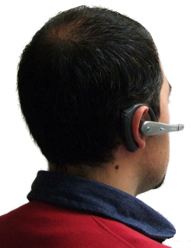
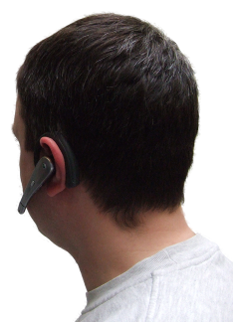
Discussing the Best of European Football in Your Mother Tongue 2016
multiparty spoken dialog between virtual & human agents
on your mobile with football fans from all over Europe
with spontaneous speech translation, diarization, simultaneous cross-lingual multimodal content linking
24 languages of 24 European teams
quiz and game shows, defining your own teams, virtual coaching
multimodal, multilingual, multiparty, multitask

Slide 14
The Basic Architecture of the 4M EURO 2016 System
Character
Modeling
and Animation
Spoken Input
Analysis
- Conversational
Dialog Engine
- Gesture
- Emotion Engine
- Action Encoder
Scheduler
Simultaneous
Translation
Diarization
Summarization
Platforms
Ontologies for
ASR, NLP, Dialog
NL Generation
and Visuali-sation
Football
Dialog Model
Games
-Videos
3D Monitors
SmartPhone
Dashboard
WebPads
Player
Emotional Speech
Synthesis
3D Character
Rendering
-Video Streaming
Narration and
Quiz and Game Engine
PlayerML

Slide 15
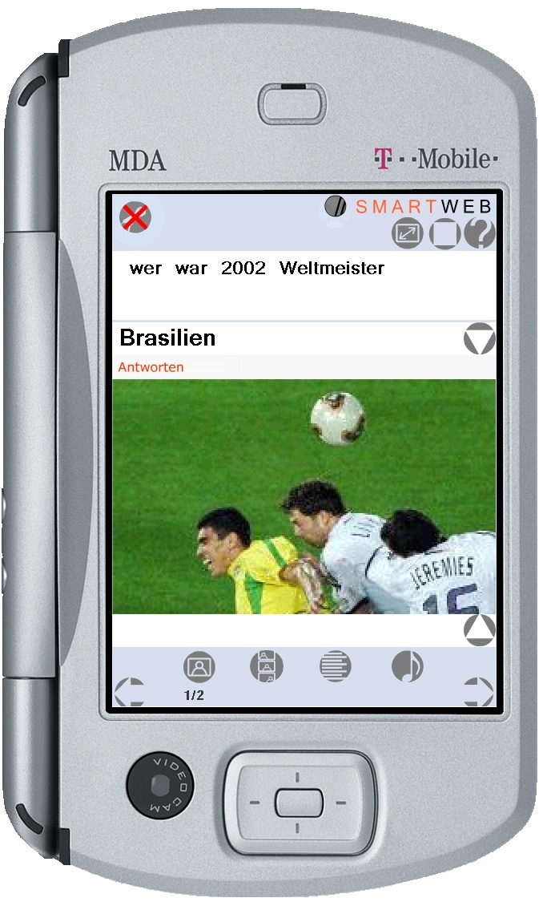
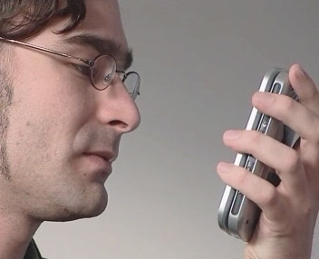
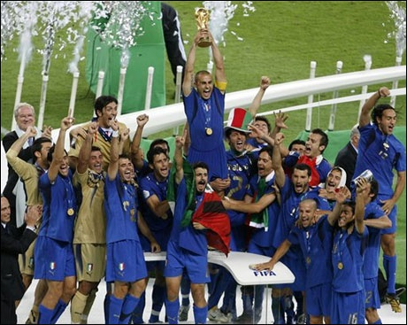
SmartWeb: Getting Answers on the Go
Who won the World Football
Championship in 2006?
Who won the World Football
Championship in 2006?
Italy
Personal guide for the FIFA
world cup
„Wie oft war diese Mannschaft [Zeigegeste] Weltmeister?“
Italy

Slide 16
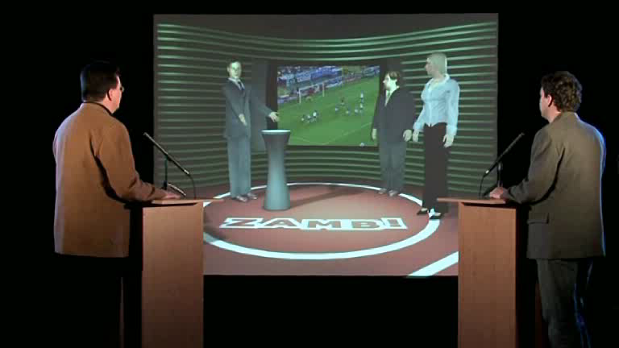
Monolingual Multiparty Football
Quiz and Game Show at DFKI

Slide 17
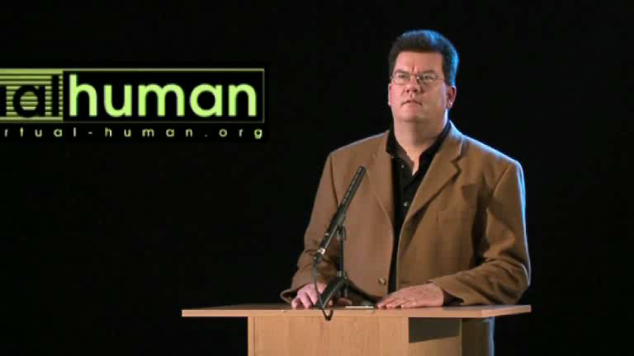
Multitask Games with Multimodal Dialogs

Slide 18



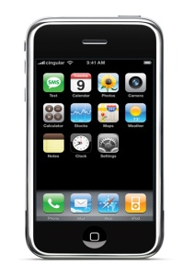
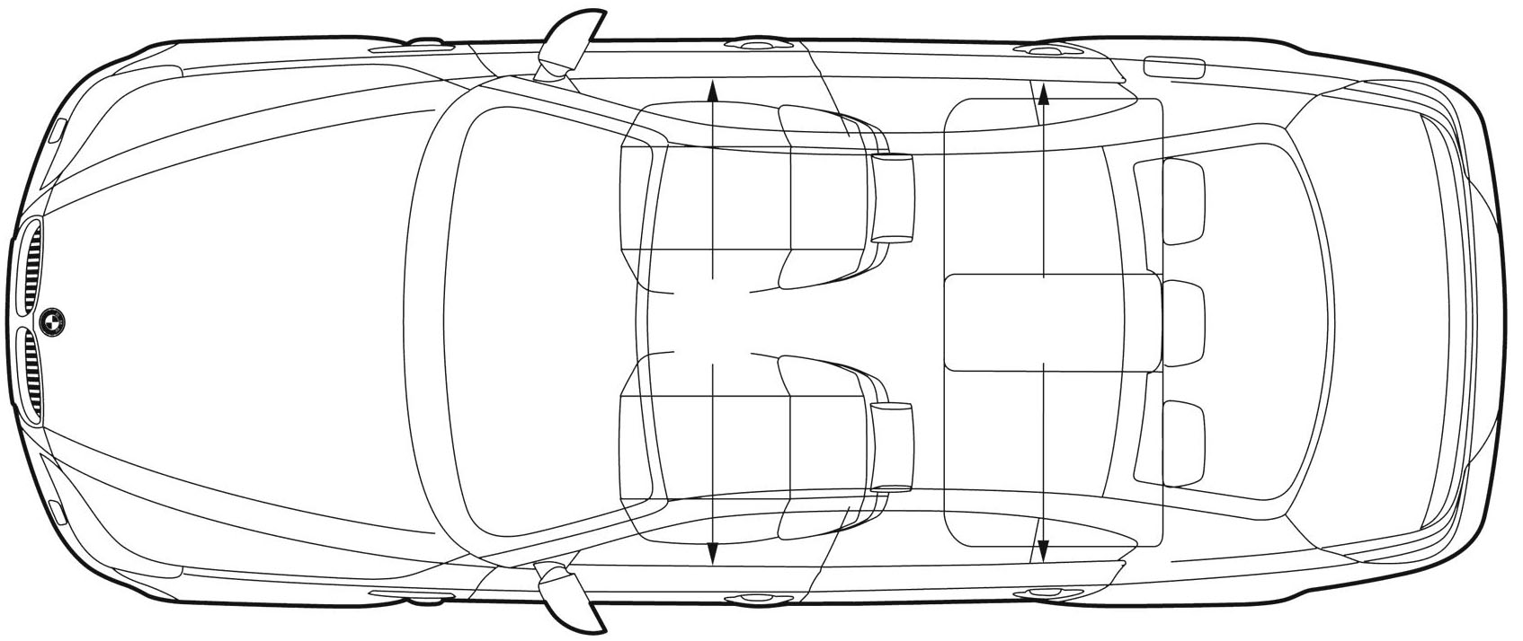

Multimodal Computing: Speech and Car Sensors
Front_Left 93.3
Rear_Right 60.2
high-end weight sensors provided by
Me 91.8
60.2
-> Front_Left
93.3
Me 61.5
-> Rear_Right
Weight sensors and microphones in the car take measures / capture speech on the respective seats
Values and speech features are broadcasted and received by personal (nomadic devices)
Speaker models and weights are stored on personal device.
Personal devices “decode” the position information and decide, which service is allowed to use it

Slide 19
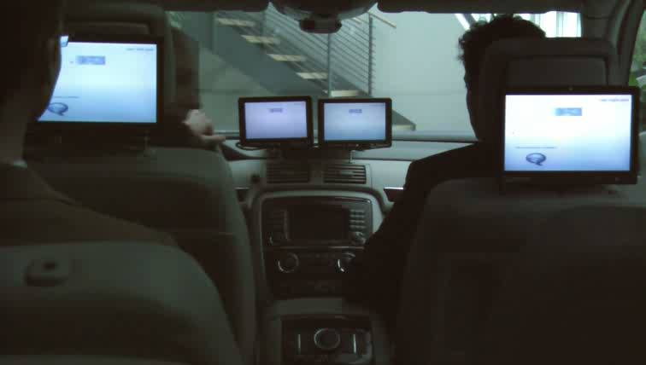
Multiparty Conversation and Speaker Identification in the Car

Slide 20
There Are Many Open Problems for the Next 6 Years:
l Integrating top-down context and dialog knowledge into low- level speech recognition processes
Exploiting more knowledge about human communication and translation strategies including psycho- and neurolinguistic inspirations.
Avoiding expensive data collections and cognitively
unrealistic training data for machine learning.

Slide 21
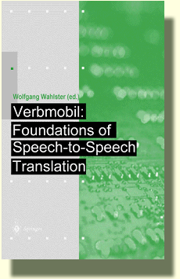

10 Years after Verbmobil +
5 Years after SmartKom/SmartWeb
+
15 and 16 November 2010, Saarbrücken: 10 Years Verbmobil
Looking Back and Looking Ahead

Slide 22
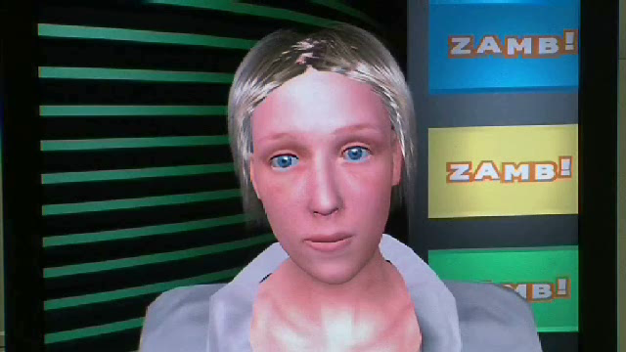
Football Tournaments Create Emotions: Emotional Speech, Emotional Facial Expressions

Slide 23
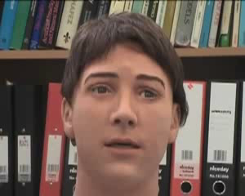
Realistic Facial Expressions combined with Emotional Speech Synthesis
Jules: the Robotic Head by Hanson Robotics used by a Team at the University of Bristol

Slide 24

Thank you very much for your attention.
© 2010 DFKI
Design by R.O.

