Slide 1
Commissioning of the LHC superconducting magnets systems:
Why an LHC Hardware Commissioning?
Specificity and complexity of this machine
Roberto Saban – 2008 Academic Training Lecture 1

Slide 2
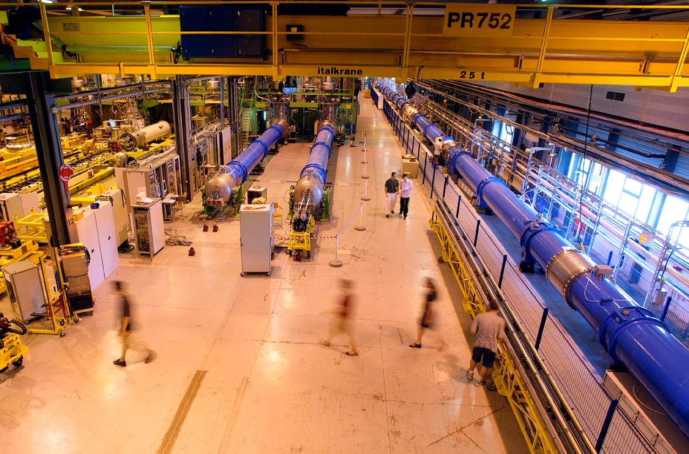
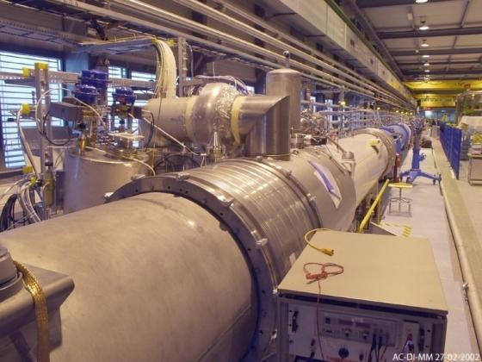
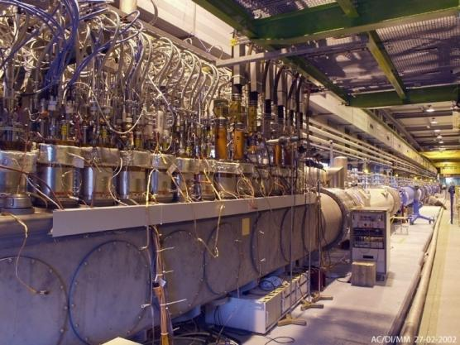
The prototype test String 2

Slide 3
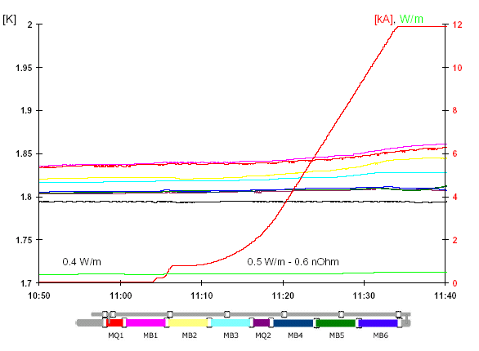
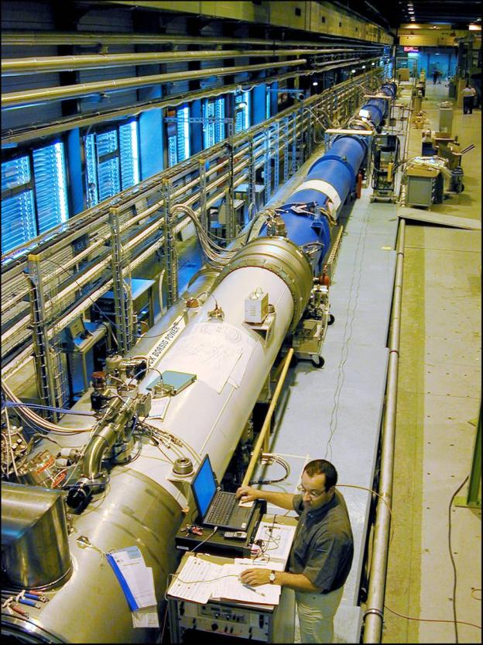
experience

Slide 4
the mandate
Sytem owners define and carry-out
◆
After the qualification for operation of the individual systems of a sector (vacuum, cryogenics, quench protection, interlocks, powering, etc.),
What tests
  the procedures and the sequence
How
  what conditions are required to start
  what conditions determine it is finished
  what conditions are required during the tests
individual system tests
Hardware Commissioning Coordination ensures that the conditions required exist
Hardware Commissioning Coordination with System Owners define and carry-out
❖
each sector will be commissioned as a whole up to the powering to nominal current of all the circuits.
What tests
  the procedures and the sequence
How
  what conditions are required to start
  what conditions determine it is finished
  what conditions are required during the tests
hardware commissioning
⬥
Validation and specific studies will be carried-out on the first commissioned sector.
and ensures that the conditions required exist

Slide 5
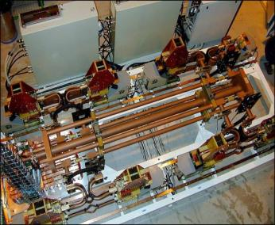
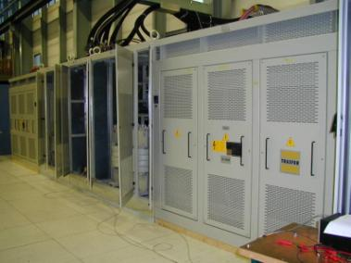
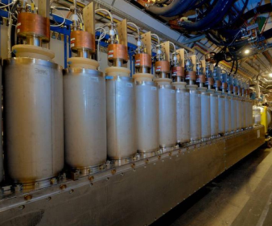
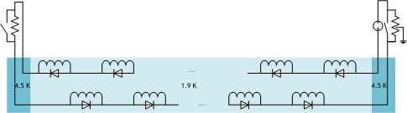
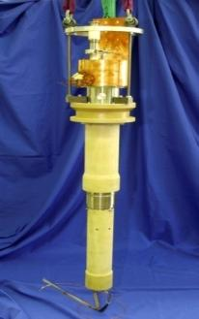
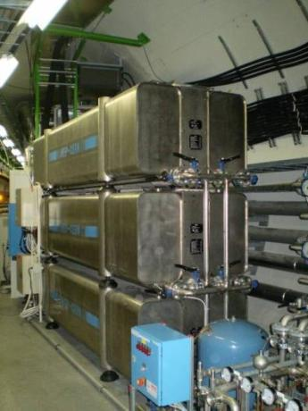
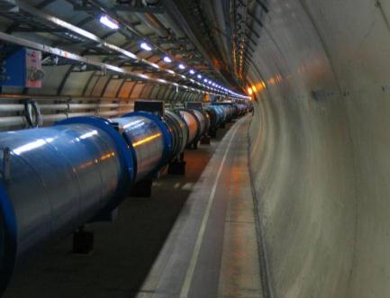
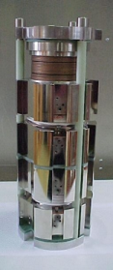
commissioning the superconducting circuits

Slide 6
the sectors of LHC
The LHC is composed of
eight cryogenically independent sectors
fed from four feed points

Slide 7
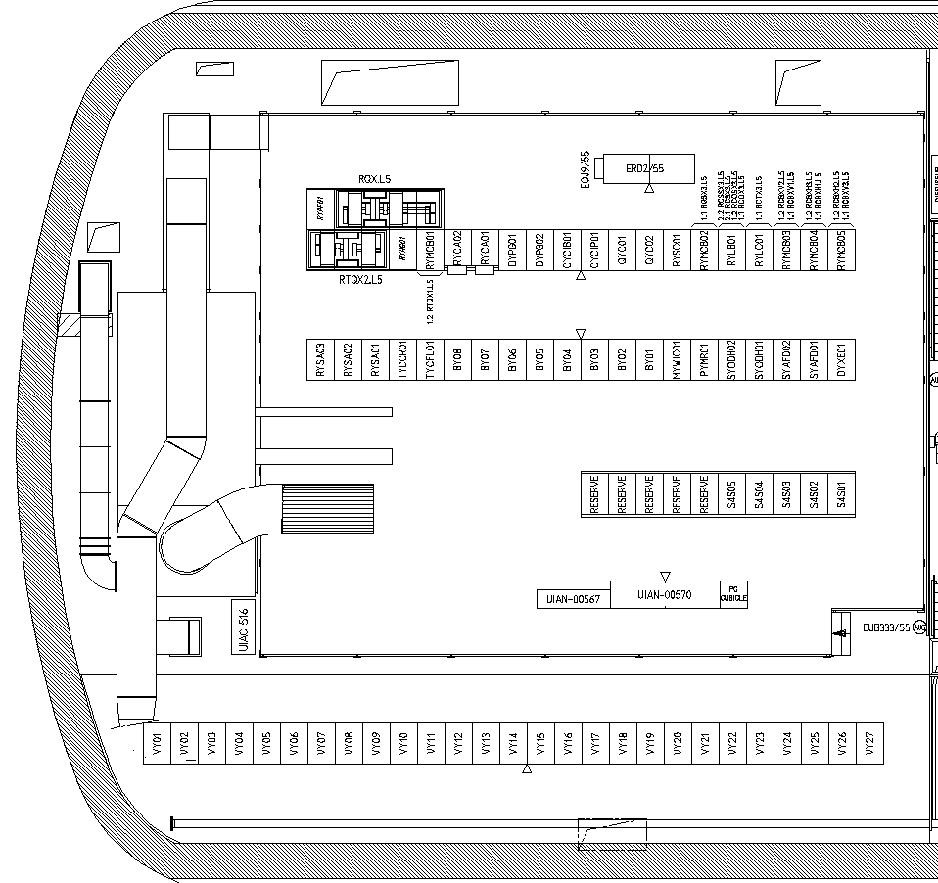
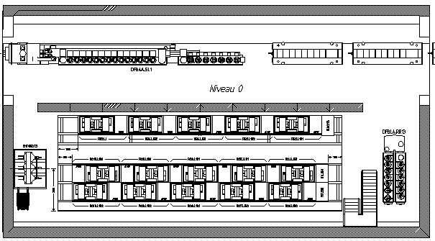
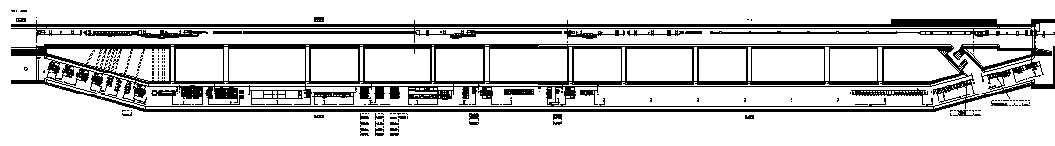
the sectors of LHC
The LHC is composed of
eight electrically independent sectors
each fed from a UA, an RR, a UJ and sometimes a USC
RR53
USC55
UA47

Slide 8
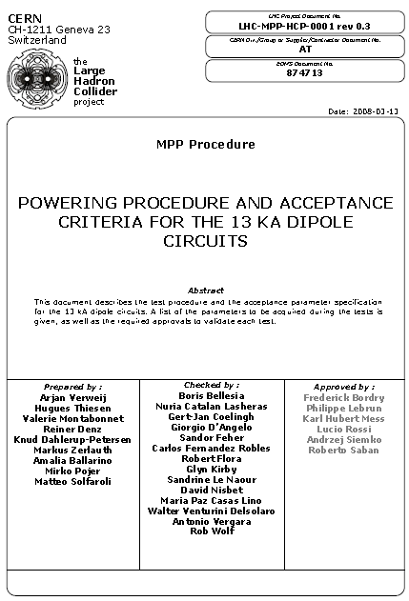
the circuits of a sector of LHC
1.9 K
4.5 K
1.9 K
4.5 K
13 circuits
14 circuits
157 circuits
6 circuits
Totalling 190 circuits

Slide 9
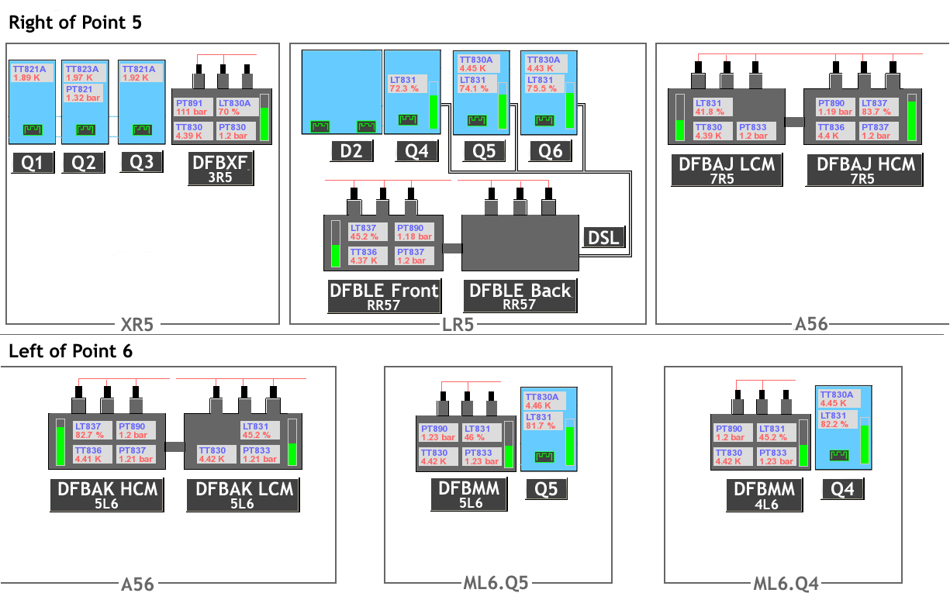
the electrical subsectors of an LHC sector

Slide 10
the superconducting magnets
The coupling via the QRL
The arc: Most of a sector is composed of 154 dipoles and 40 quadrupoles which
  are in series: dipoles in series & quads in series
  operate at 1.9 K
  the dipoles have a huge inductance 16H
  contain
    families of correctors in series
    dipole correctors
The matching sections: small subsectors
  operating at 4.5K
  often standalone magnets
  very special – often unique - magnets
The inner triplet: composed of very high gradient quadrupoles and a dipole which
  operate at 1.9K
  contains a complex electrical circuit with nested converters
All coupled via the headers in the cryogenic distribution line
Any repair or exchange of a component has an impact on the whole sector

Slide 11
the dipole circuit
154 dipoles
Circuit inductance 16 H
Energy stored at nominal current (11.850 A) is 1.12 GJ per sector
The large magnetic energy (1.12 GJ) stored in the magnets of one sector (2.5 x Hera) requires extremely reliable systems to detect failures and safely dump the energy in a controlled way
3 km

Slide 12
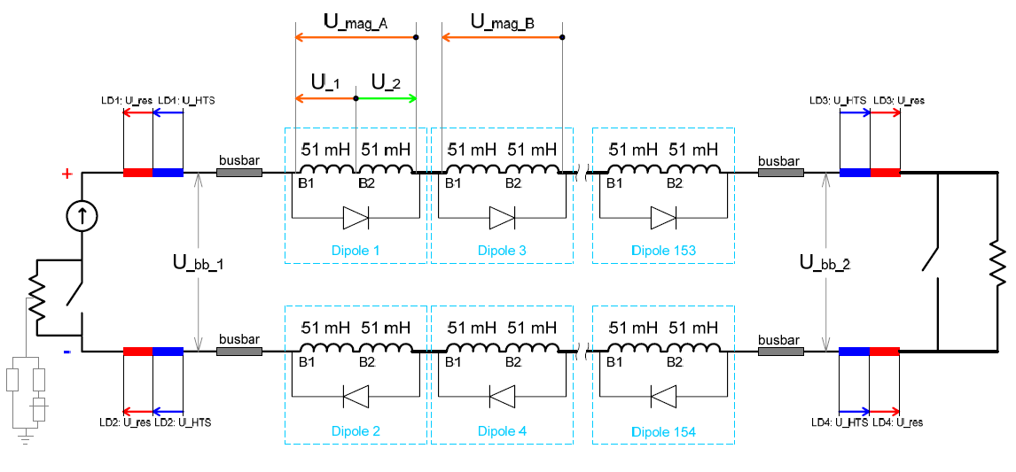
the quench detection system
Magnets
U_{_res} = U_{_1}+ U_{_2}
Threshold is 100 mV during 10 ms
The current leads
Typical resistance 7 μΩ
Threshold is 3 mV during 1 s
U = R x I
Bus
U_{_res} = U_{_bb_1}+ U_{_bb_2} – N ( U_{_mag_A}+ U_{_mag_B})/2
Threshold is 1V during 1 s
Quench detectors
Current leads
Local on each dipole
Global detectors on the bus bars

Slide 13
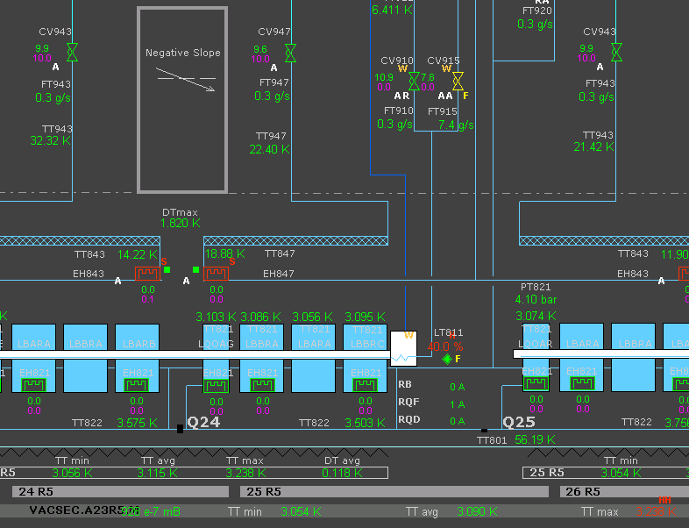
what needs to be tested for the cryogenic system
Cryogenic plants of unprecedented capacity (18 kW at 4.5 K) and including main components at the frontier of today’s technology (cold compressors for the 1.8 K refrigeration unit)
Technological frontier
Full scale validation of cooling scheme (cool down and warm ups, quench recovery, redundancy)
Cryogenic circuit integrity
DFB & CL
Instrumentation
Leak tightness
Insulation vacuum
Commissioning of the complete cryogenic system

Slide 14
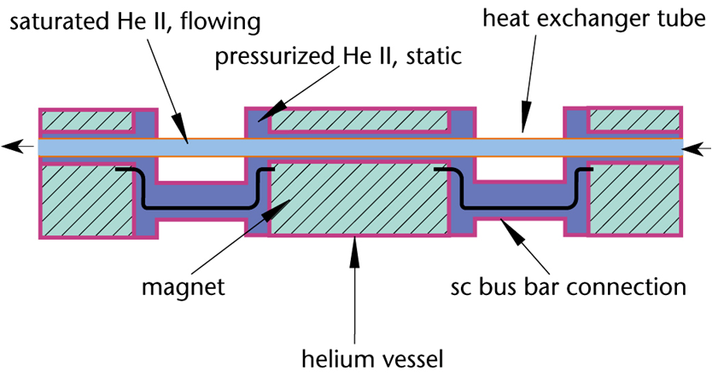

the cooling scheme
vacuum vessel

Slide 15
Helium II in the LHC
λ line
Pressurized He II
Saturated He II

Slide 16
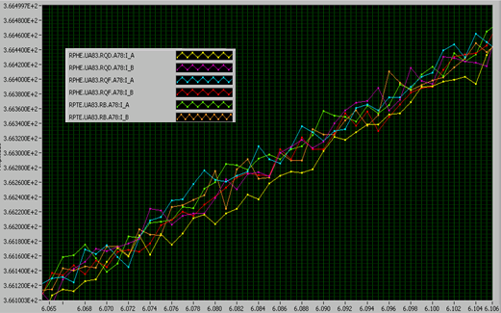
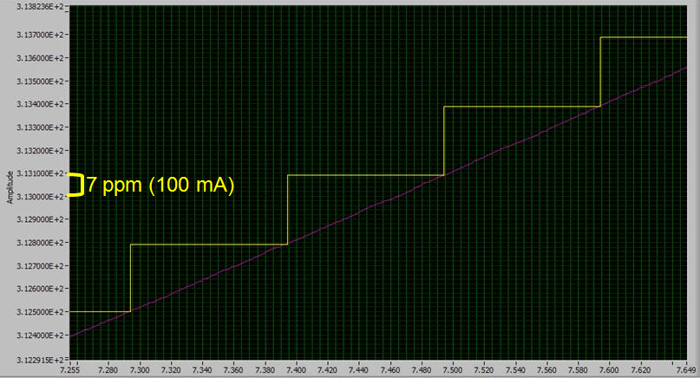
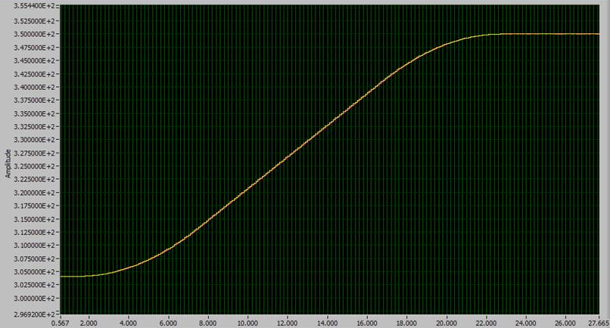
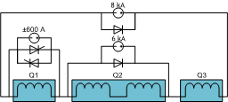
what needs to be tested for the power converters
Regulation loop
Free-wheel system at nominal current with high time constant
Compatibility with QPS at start up
Tracking
Inner triplet
Technological frontier
2ppm
Power converters with unprecedented precision (a few ppm) over a very large dynamic range (10⁴)

Slide 17
the superconducting circuits: the inventory
Circuit Type | Sector |  |  |  |  |  |  |  | LHC
 | 1-2 | 2-3 | 3-4 | 4-5 | 5-6 | 6-7 | 7-8 | 8-1
13 kA | 3 | 3 | 3 | 3 | 3 | 3 | 3 | 3 | 24
Independently Powered Dipoles | 3 | 2 | 2 | 3 | 1 | 0 | 2 | 3 | 16
Independently Powered Quadrupoles | 14 | 7 | 6 | 13 | 12 | 5 | 7 | 14 | 78
600A with Energy Extraction | 23 | 27 | 28 | 24 | 23 | 27 | 27 | 23 | 202
600A Energy Extraction in Converter | 14 | 20 | 20 | 14 | 14 | 20 | 20 | 14 | 136
600A no Energy Extraction | 16 | 9 | 2 | 9 | 9 | 2 | 9 | 16 | 72
80-120A Correctors | 50 | 37 | 22 | 33 | 33 | 22 | 37 | 50 | 284
TOTAL | 123 | 105 | 83 | 99 | 95 | 79 | 105 | 123 | 812
Industrial quantities
Circuit Type | Sector |  |  |  |  |  |  |  | LHC
 | 1-2 | 2-3 | 3-4 | 4-5 | 5-6 | 6-7 | 7-8 | 8-1
60A Closed Orbit Correctors | 94 | 94 | 94 | 94 | 94 | 94 | 94 | 94 | 752

Slide 18
the methodology
Individual System Tests of Powering Interlock Control
300 K
Test of power converters connected to the DC cables in short circuit, including controls for powering, ramp, monitoring
Individual System Tests of the Quench Protection and Energy Extraction Systems
90 K
Power Converters
not connected to Magnets
Electrical Quality Assurance
Industrial quantities
1.9 K
Post-Mortem System tests
Interlock tests of a powering subsector prior and after connection of the power cables to the DFB leads
connexion of power cables
to the current leads
Commissioning of the electrical circuits one by one or in groups at low, intermediate and nominal currents
Power Converters
connected to Magnets
Commissioning of all the electrical circuits of the sector powered in unison to nominal current with nominal ramp rates

Slide 19
the methodology for the test procedures & automation of procedures and analysis
The objectives are:
the validation of the protection strategies under the different failure scenarios and
the evaluation of the behavior and of the performance of
  the magnet chain,
  the current leads and
  the power converters
during a normal LHC ramp, in steady state and during a ramp down of the current.
Industrial quantities

Slide 20
the methodology for the test procedures & automation of procedures and analysis
Verification of the Energy Extraction System at different current levels
Verification of the Protection Interlocks
Configuration of the Power Converter
Industrial quantities

Slide 21
the methodology for the test procedures & automation of procedures and analysis
Industrial quantities

Slide 22
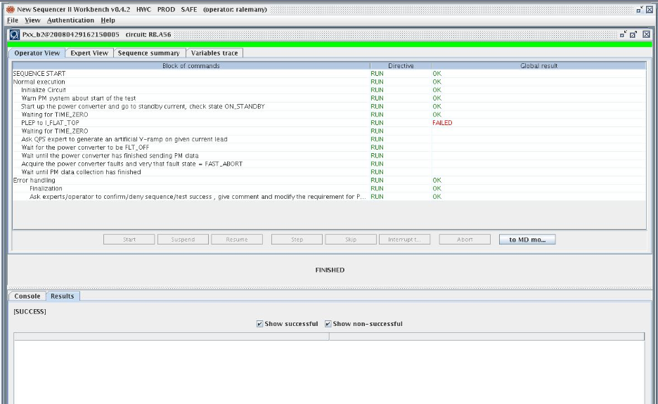
automation of procedures
Industrial quantities
Approved and reproducible test sequences
Assistance to operators
Automatic recording of test results

Slide 23
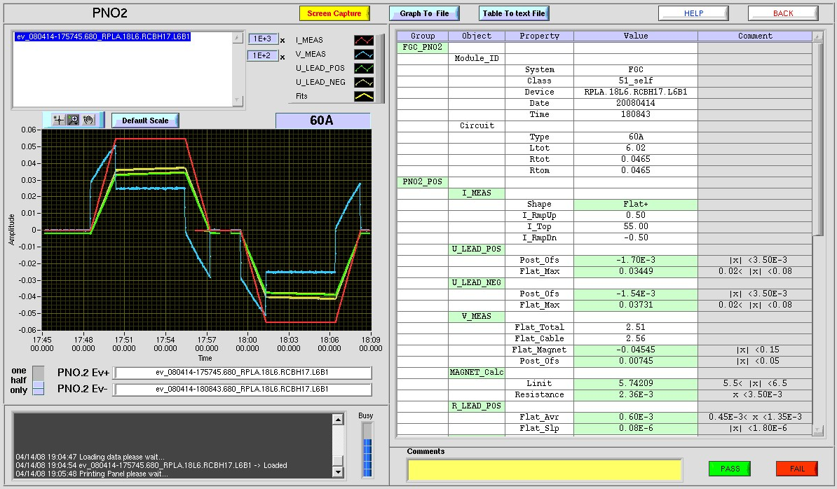
computer assisted analysis
Industrial quantities

Slide 24
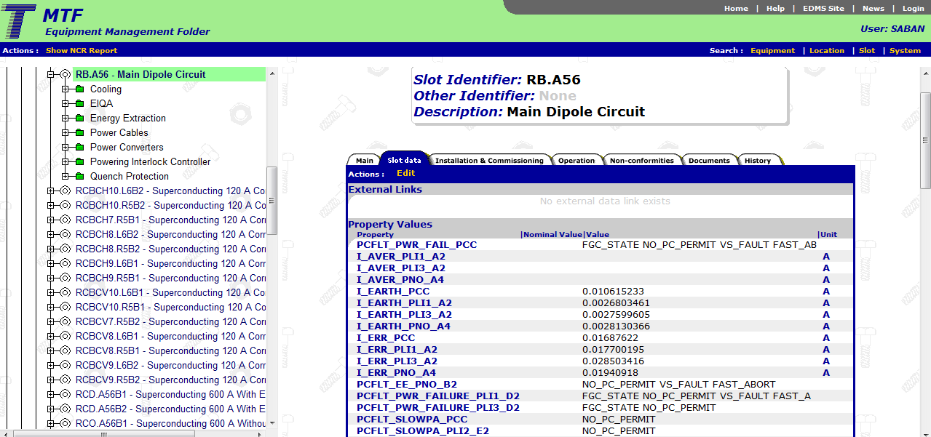
quality control
Industrial quantities
Automated recording but also manual data entry
Provides data for analyis tools
Ensures perennity of data

Slide 25
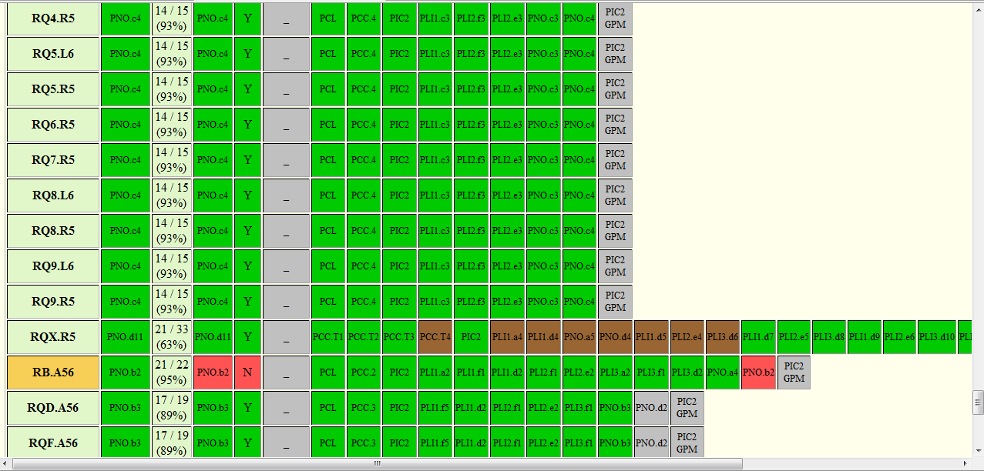
real-time follow up of tests

Slide 26
standard technologies
Standard technologies
Normal AC distribution
Networks
UPS AC distribution
Fieldbuses
Demineralized water
Controls equipment
Ventilation

Slide 27
the short circuit tests
RR53-USC55
UA47
RR57-UJ56
UA43
UJ33
UA63
UA67
UA27
RR73 UJ76
UA23
UA83
RR77
UA87
15 underground areas
RR13-UJ14
RR17-UJ16

Slide 28
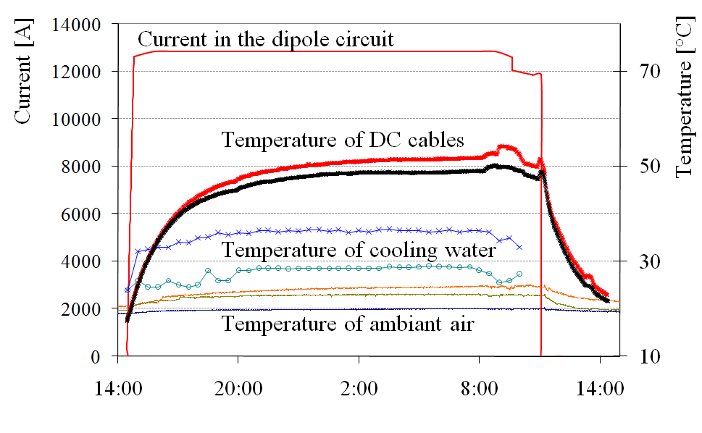
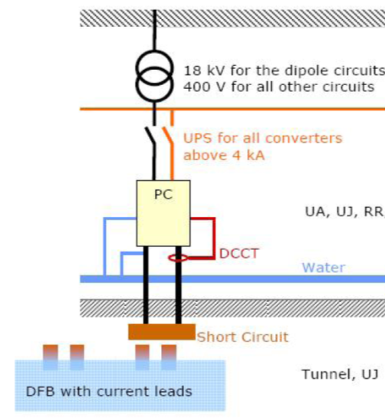
the short circuit tests
Networks
Fielbuses
Gateways
DC cables
Ventilation
Cooling water
Power converter
Energy extraction system
AC distribution
Powering interlock controller

Slide 29
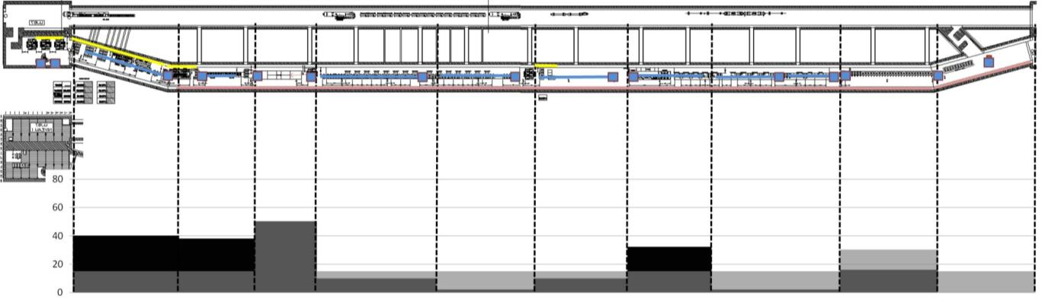
the short circuit tests
Measurement of ambient air temperature close to the electronics racks
UA67
Pt6
S67
Vacuum Cryogenics
Beam diagnostics
Beam dumping system
and Power
Converters
Electrical
Substation
MS
Power
Converters
Beam dumping system
Main
dipole
PC
Main
quads
PCs
EE
600A PC
EE racks
MS
Power
Converters
Power
Cables
kW
Power
Cables
 | Zone1+UJ66 | Zone2 | Zone3 | Zone4 | Zone5 | Zone6 | Zone7 | Zone8 | Zone9 | Zone10
Vent. | 15kW | 15+15 kW | 15+15 kW | 15 kW | 15 kW | 15kW | 15kW | 50kW | 15kW | 15kW
Syst. | 0kW | 16 kW | 4 kW | 32 kW | 10 kW | 2 kW | 10 kW | 50 kW | 38 kW | 40 kW
m | 24 | 19.8 | 20.2 | 18.9 | 21 | 22.2 | 27 | 13.8 | 16.5 | 24
Tot
215kW
215kW
Addition of ventilation ducts and of local ventilation units

Slide 30
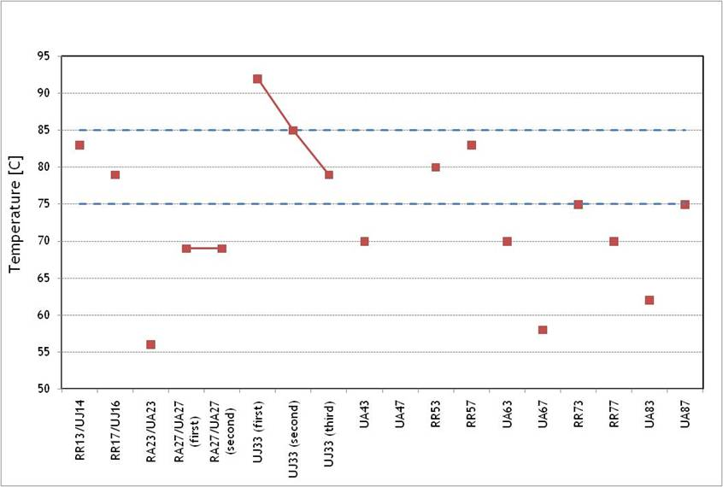
the short circuit tests
Measurement of cable temperature during the 24-hour run

Slide 31
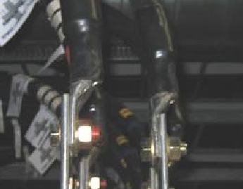
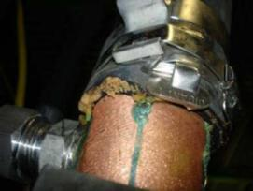
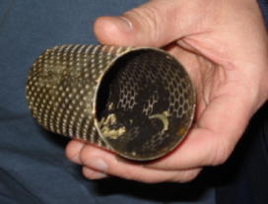
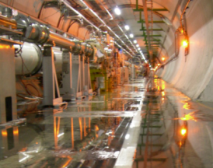
support to operation: infrastructure systems
Before global commissioning of complex/large systems can start
  the individual commissioning of the infrastructure systems is carried out
  tuning with the load is carried out
  heat runs are carried out
  performance is measured and recorded
  frequent and multiple adjustments are carried out
  performance is monitored throughout the commissioning
  surprises are often encountered
Standard technologies

Slide 32
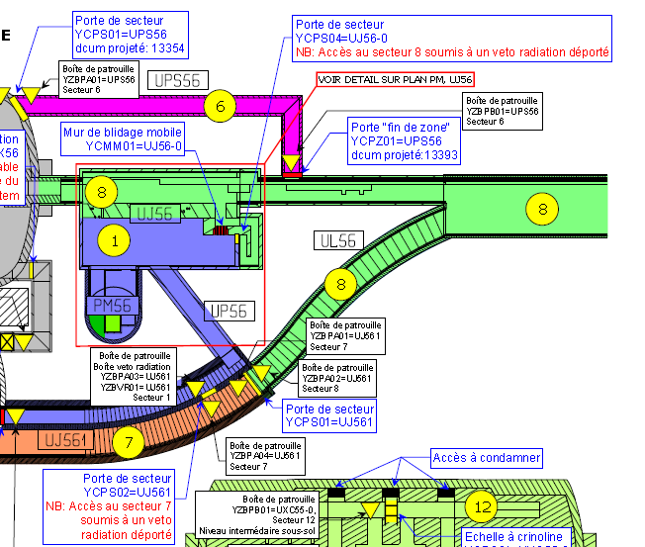
Access safety and control systems
The LHC access system was commissioned during the first week of January 2008 by a joint team in collaboration with the supplier's team.
From early April access to the LHC is possible with dosimeter and biometric control.
All the sectors in Hardware Commissioning today make use of the system
Standard technologies
We want to
  ensure that people who do not need to be there cannot access the sector
  be sure that nobody is in there during the first cool down and the first warm up as well as when we power a sector
  learn how to use the system
  commission the system

Slide 33
coupling and interdependencies of the systems
  complexity for the diagnostics
    quantity of signals spread over different systems
    variety of instrumentation (voltage taps, current sensors, heaters, cryogenic instrumentation, etc.)
  interdependency for safe operation
    interlocks,
    QPS,
    PCs
    but also cooling, ventilation, AC distribution – normal, UPS, safety network
Coupling of the systems

Slide 34
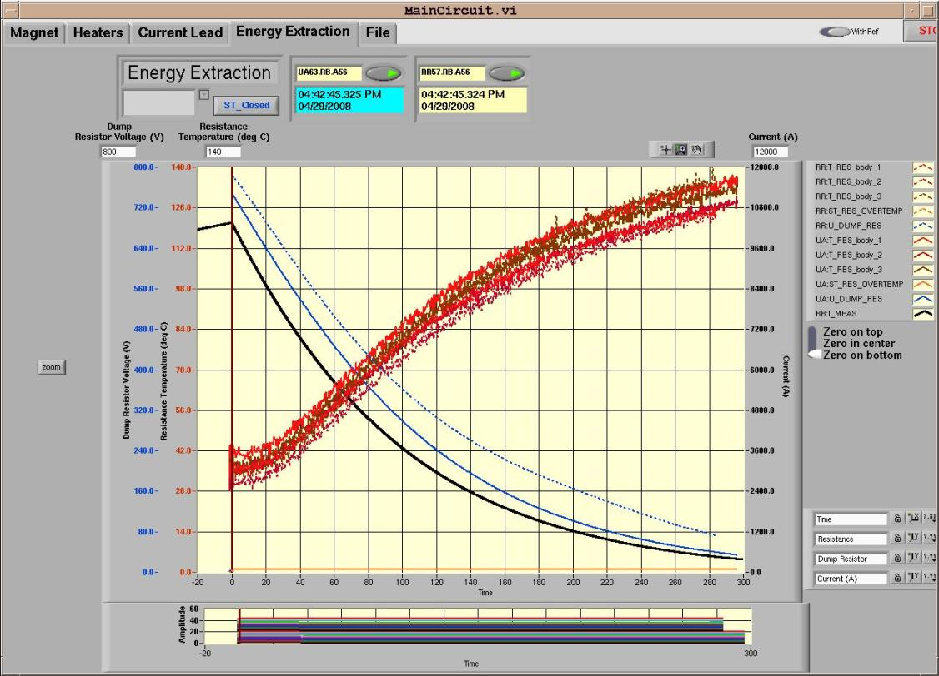
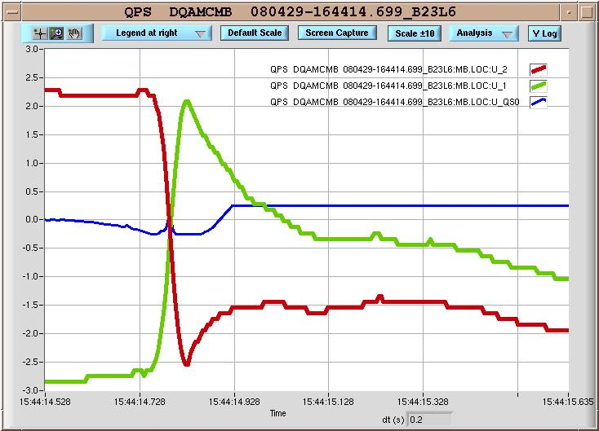
interdependencies of the systems
Coupling of the systems

Slide 35
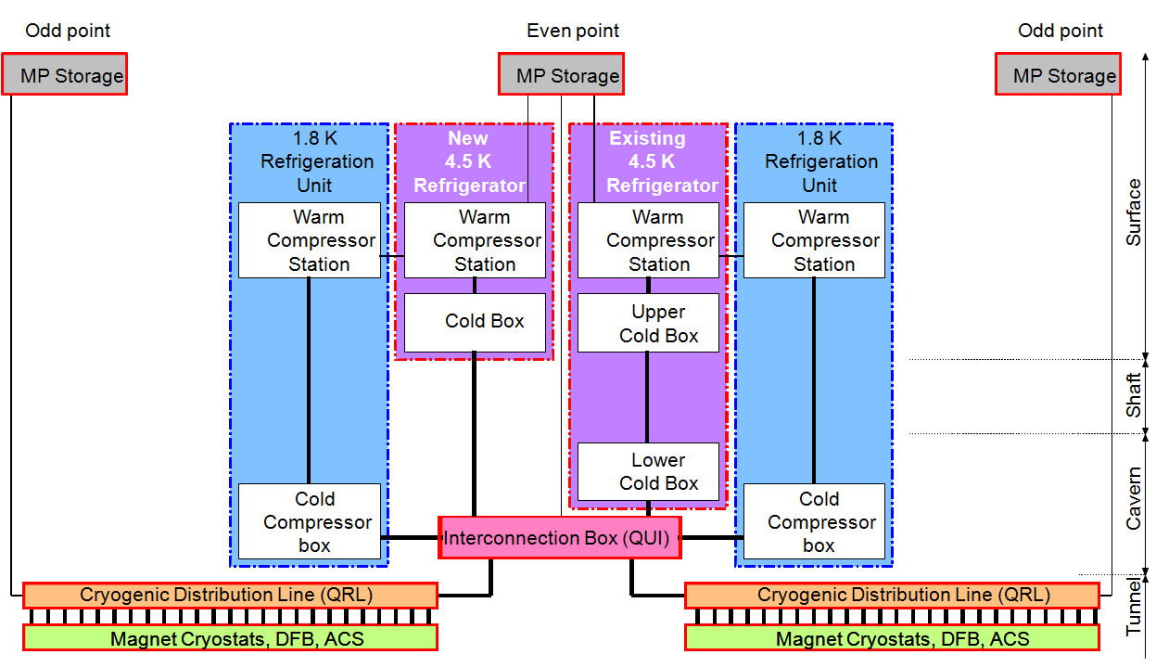

Geographical distribution
Geographical distribution
50 m x 50 m
up to 100 m
30 m x 30 m
3’000 m

Slide 36
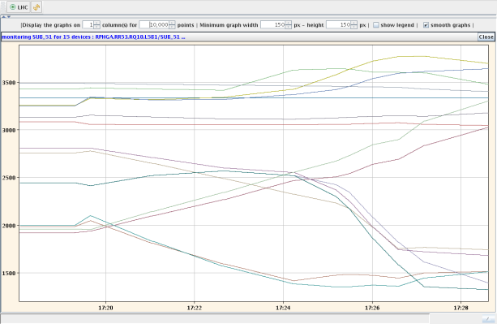
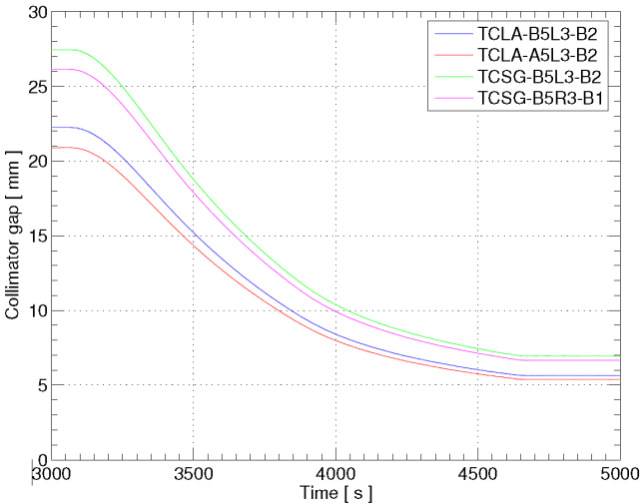
Software for operation, controls and diagnostics
Using the final software foreseen for operation for the commissioning of the machine systems
  Sequencer
  Logging system
  Post mortem system
  On-line databases
  Industrial supervision systems
1
Dry runs
  Injection kickers system
  LHC Beam dumping system (kickers, energy tracking, diagnostics,)
  Beam instrumentation (loss monitors, position monitors, current transformers, screens)
  Power converters in simulation mode
  Collimators
  Timing system
  Communication with experiments (handshakes, modes, fill number, beam based measurements, etc.)
  Post mortem data acquisition system
  Squeeze
2

Slide 37
... in summary
Technologies at or beyond the start of the art
  Superconducting magnets operating close to the limit of the load line
  Cryogenic plants of unprecedented capacity (18kW at 4.5K) and including main components at the frontier of today’s technology (cold compressors at 1.8K)
  Power converters with unprecedented precision (a few ppm) over a very large dynamic range (10⁴)
  Each sector stores a large magnetic energy (1.2 GJoule) in the magnets (2.5 x Hera) and therefore requires extremely reliable systems to detect quenches and safely dump the energy in a controlled way
High tech components in industrial quantities (1800 circuits, large circuits 154 dipoles, 16 H, 12kA) which justifies
  methodology for test procedures,
  automation of procedures and analysis
  quality control

Slide 38
... in summary
Standard technologies
  in infrastructure systems (electrical, ventilation, water cooling, networks, fieldbuses, control infrastructures, etc.)
  in large quantities,
  various types and
  stretching over large distances
Coupling and interdependencies of the systems
  complexity for the diagnostics (quantity of signals, spread over different systems ) & instrumentation (voltage taps, current sensors, heaters, flow meters, cryogenic instrumentation, etc.)
  interdependency for safe operation (interlocks, QPS, PCs but also cooling, ventilation, AC distribution – normal, UPS, safety network)
Geographical distribution which
  extends the size of the installation (e.g. cryogenics: surface buildings 50 x 50 m, shafts 100 m deep, tunnel 2 x 3 km long)

Slide 39
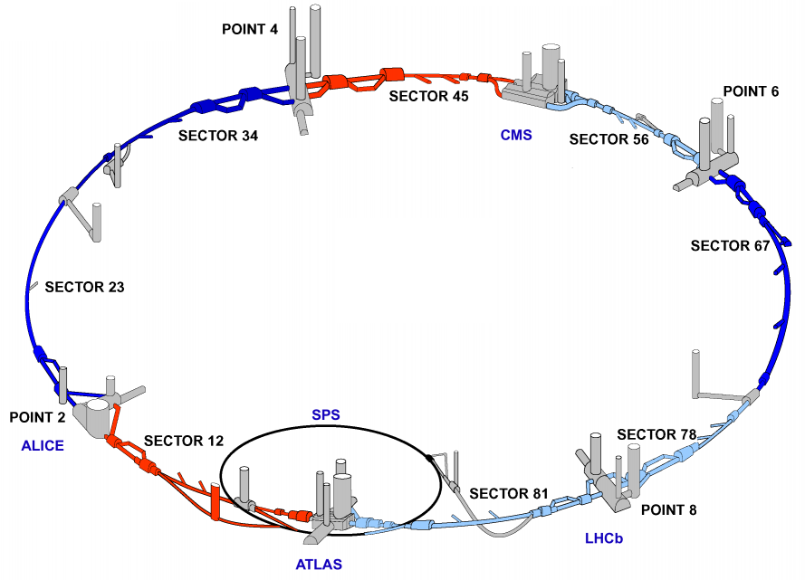
the superconducting circuits but also all the other systems
the RF system
the beam dumping system
the warm magnets
the injection systems
the collimators
the beam instrumentation

Slide 40
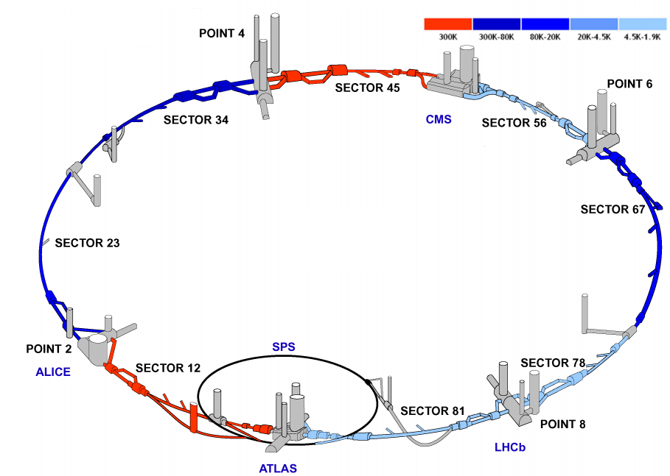
... where are we today cool down status

Slide 41
... where are we today cool down status
Sector | Average T [K] | Status
12 | 300 | Flushing
23 | 22 | Cool down
34 | 177 | Cool down
45 | 300 | Commissioned to 5 TeV except for the triplet Inner triplet now connected Consolidation complete Cool down starts in two weeks
56 | 2 | Fully commissioned to 5 TeV Dipoles and quadrupoles being trained to 7 TeV
67 | 25 | Cool down
78 | 2 | Partially tested in June 2007 Inner triplet connected Powering tests start tomorrow
81 | 2 | Powering tests start in one week

Slide 42
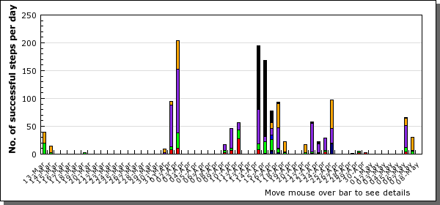

... where are we today powering tests of sector 56
ML6
ARC
XR5
LR5
Week end
Easter
Week end
Open
Days
Week end
400 kV power cut
Week end
400 kV power cut
May 1st + Ascension
Training campaign on the dipoles starts
Powering Groups of Circuits

Slide 43
... where are we today powering tests of sector 56
A strategy, where the initial beam energy is at least 5 TeV, is proposed to gain time with the training of magnets and meet the summer deadline.
The fact that we can easily reach that energy level has been proven both in Sector 45 and Sector 56.
Nevertheless, we have started a quench campaign on the dipoles of Sector 56 to find out how much time we will need to get to 7 TeV.
Current [A] | Equivalent Energy [TeV] | Magnet (Position) | Date
10004 | 5.91 | 3362 (A28L6) - 2245 (B29R5) | 28/04/08
10227 | 6.04 | 3370 (A29L6) | 28/04/08
10357 | 6.12 | 3372 (A23L6) | 29/04/08
10546 | 6.23 | 3188 (A15R5) | 30/04/08
10652 | 6.29 | 3368 (C32R5) | 06/05/08
10714 | 6.33 | 3246 (A10L6) - 3387 (C16L6) | 07/05/08
10751 | 6.35 | 3335 (A21R5) | 09/05/08

